Slide 1
Student life
Basic 10 – Unit 6a

Slide 2
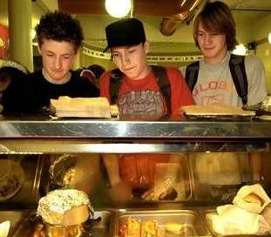
1. Teen age
Have time + Energy …. But No Money

Slide 3
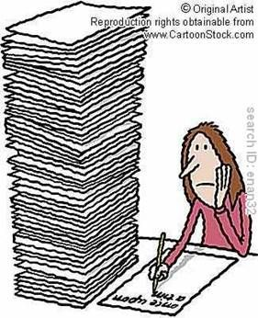
2. Working age
Have money + Energy …. But No time

Slide 4
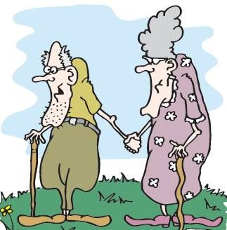
3. Old age
Have money + time …. But No energy

Slide 5
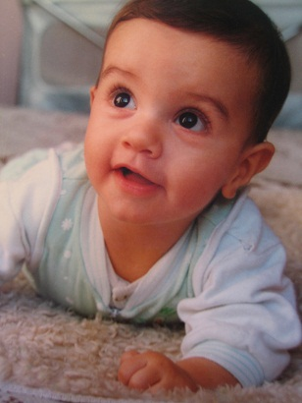
Baby

Slide 6
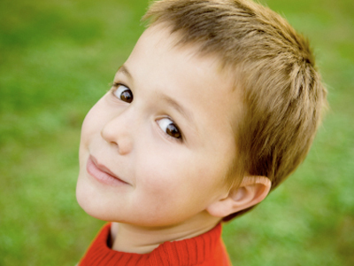
Child

Slide 7

Youth

Slide 8
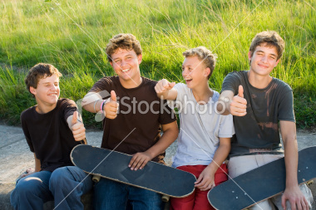
Young

Slide 9
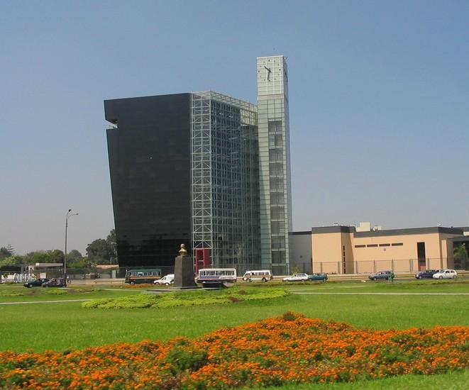
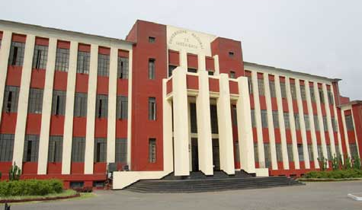
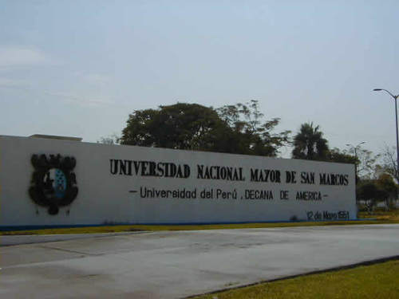
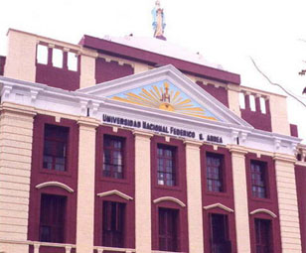
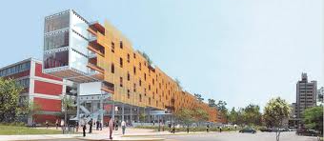

Slide 10
1. Teen age
Have time + Energy …. But No Money

Slide 11

Graduate

Slide 12
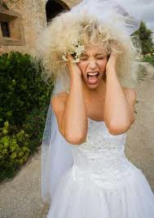
Get married

Slide 13
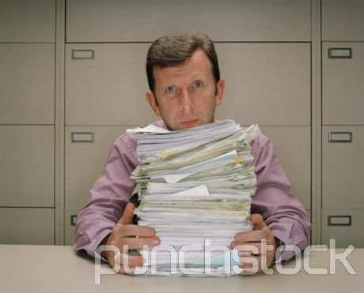

Slide 14
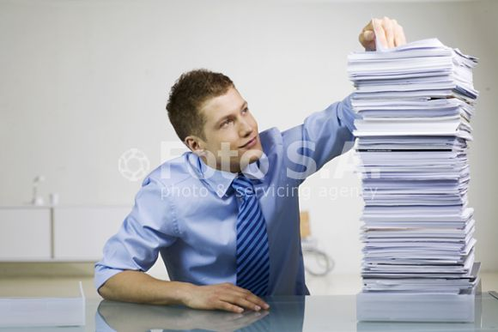

Slide 15
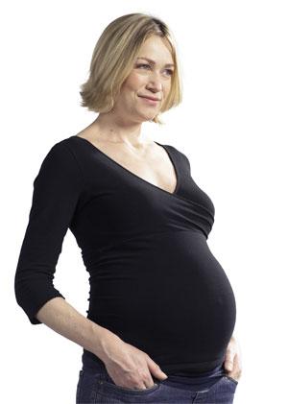
Have a baby

Slide 16
A cold

